Slide 1

Superstore data analysis using SAS
Rashpinder kaur chahal

Slide 2
Dataset description: Superstore
The dataset contains sales details of different stores of a supermarket
chain that has multiple stores in different parts of the US.
With columns such as:
Ship Mode
Segment
Country
City
State
Postal code
Region
Category
Sub-category
Sales
Quantity
Discount
Profit
Filetype: CSV

Slide 3
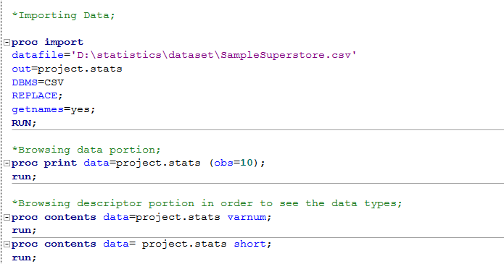
Importing and Browsing Dataset

Slide 4
Univariate Analysis
Categorical variables And Numerical variables

Slide 5
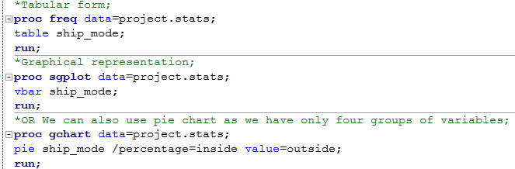
Shipment Mode (Categorical Variable)
Shipment Mode is used because mode of shipment is important as we need to
analyse which shipment mode is most used;

Slide 6
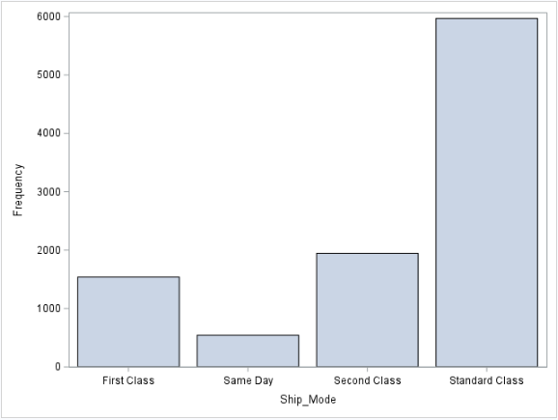
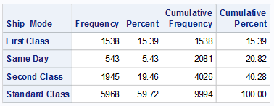
The analysis focuses on the distribution of the variable "Shipment mode" within the dataset.The data reveals a total of 9994 observations, First Class-1538 ie:15.39% Same Day-543 ie:5.43% Second Class-1945 ie:19.46% Standard Class-5968 ie:59.72%

Slide 7
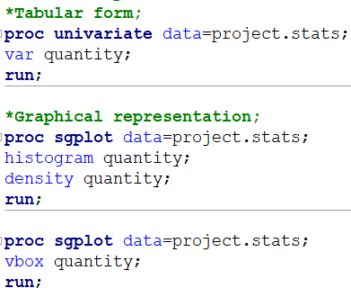
Quantity (Numerical Variable)

Slide 8
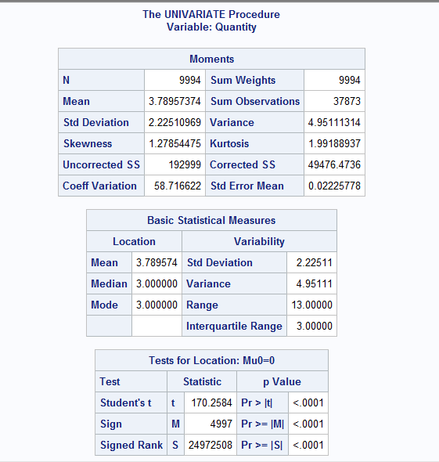
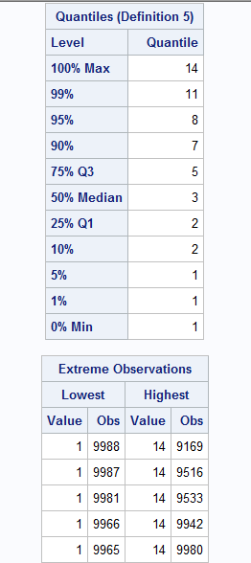
Total observation are 9994 with
average quantity is 3.7895 for all the observations, standard deviation is
2.225 that means the spread ness of data, we have positive skewness value
i.e., right skewed, value is 1.2785
Similarly, kurtosis is 1.991 which is between threshold (-3,3)
Range is 13 i.e., max-min =
14-1=13
The value of Q1=2 (75% data have quantity value more than 2 and 25% data have less than 2)
Similarly, Q3=5 (25% data for quantity is more than 5 and 75% data for quantity is less than 5)

Slide 9
Skewness indicates the asymmetry of the distribution of data:
• Negative skewness (left-skewed) means the tail on the left side of the distribution is longer or fatter than the right side. It indicates that the bulk of the data is concentrated on the right.
• Positive skewness (right-skewed) means the tail on the right side is longer or fatter than the left side, indicating that the bulk of the data is on the left.
Kurtosis measures the "tailed ness" of the distribution:
• Positive kurtosis (leptokurtic) indicates a distribution with tails heavier than a normal distribution and a sharper peak.
• Negative kurtosis (platykurtic) suggests lighter tails than a normal distribution and a flatter peak.

Slide 10
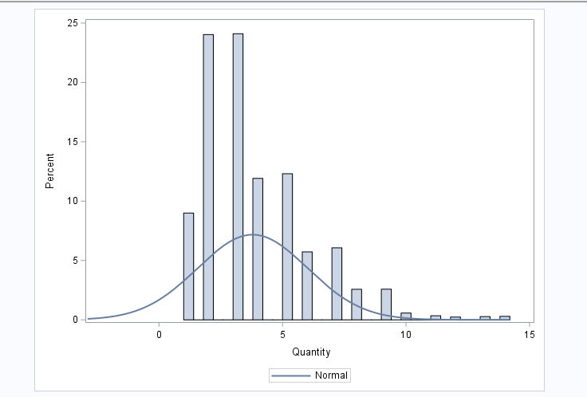
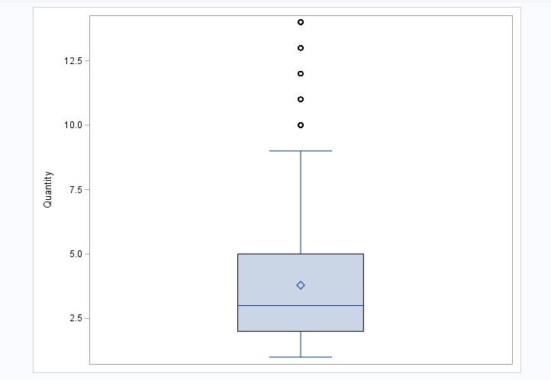
Kurtosis is between the threshold value i.e. (-3,3), so there is no sharp peak in the graph and this indicates that there
are fewer potential outliers(Q1-1.5(IQR)),(Q3+1.5(IQR))=2-1.5*3,5+1.5*3=(-2.5,9.5)
Skewness is positive which indicates that the outliers exist in the right side of the data (can be seen by whiskers in box plot as well as tail in density curve).
Mean and median values are not approximately similar (we can see that in box plot) which indicates that the value of mean is affected by the outliers and that the data distribution is not normal.

Slide 11
Bivariate Analysis
Numerical * numerical , Categorical * categorical
Categorical * numerical

Slide 12
Checking CORRELATION between all continuous numerical
variables using Correlation Matrix

Slide 13
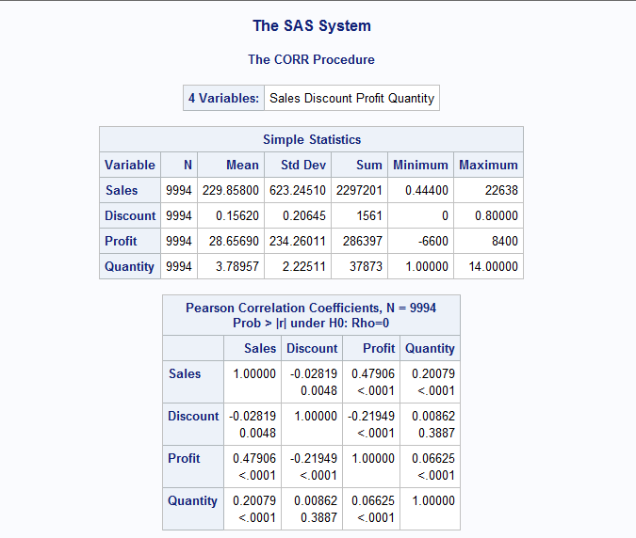
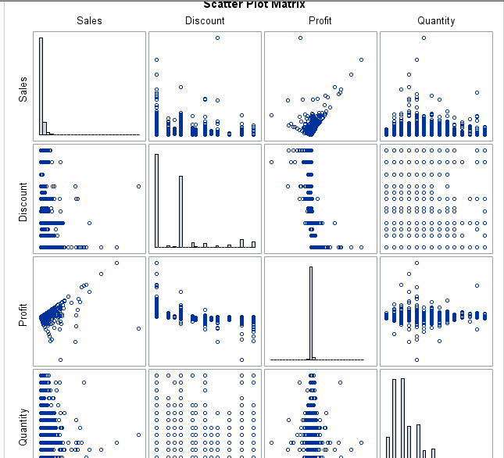

Slide 14
SALES AND PROFIT
H0: R=0: Profit is not affected by the number of Sales made in superstore.
H1: R!=0: Profit is affected by the number of Sales made in the superstore.

Slide 15
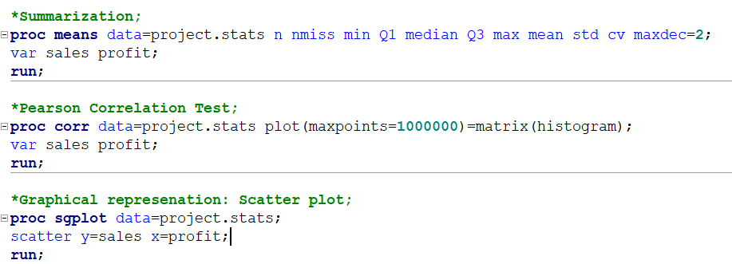

Slide 16
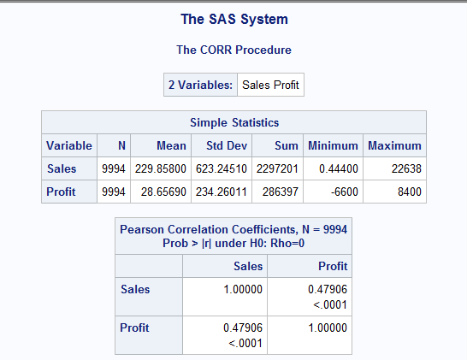

Slide 17
Prediction of correlation through:
R (coefficient of correlation):
0.5 ≤ |r| → High linear correlation
0.3 ≤ |r| < 0.5 → Medium linear correlation
0 ≤ |r| < 0.3 → Low linear correlation
r=0➔no linear correlation
r= +1 or -1➔perfect linear relationship
P-value: P-value is more than 5% than we fail to reject null hypothesis (R=0) otherwise we accept alternative hypothesis.
Conclusion of Pearson correlation test on Sales and profit
The coefficient of correlation (r)= 0.47906 i.e., between 0.3 < |r| < 0.5 which is medium linear correlation.
P-value <.0001 which is less than alpha p-value 5% that means we reject null hypothesis, and we accept alternative hypothesis which states that Profit is affected by the number of Sales made in the superstore.

Slide 18
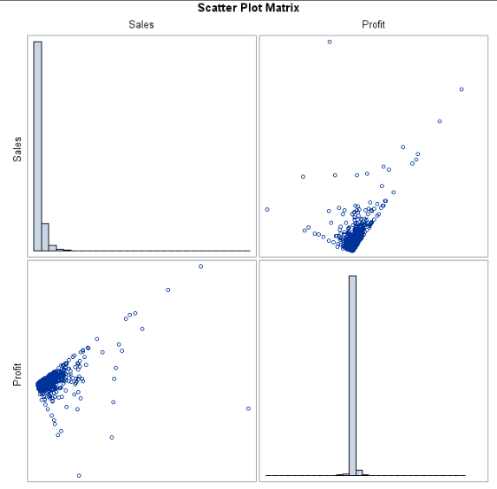
DECISION AND CONCLUSIONS
Based on the results, we can state the following:
Sales and profit have a statistically significant linear relationship (r = 0.47906, p < .001).
The direction of the relationship is positive (i.e., sales and profit are positively correlated), meaning that
these variables tend to increase together (i.e., greater profit is associated with greater sales).
The magnitude, or strength, of the association is moderate (0.3 < | r | < 0.5).

Slide 19

Regression modelling on Sales and Profit

Slide 20
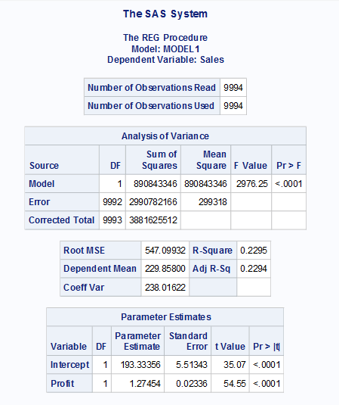

Slide 21
R-Squared
The R-squared value indicates the proportion of the variance in the dependent variable that is explained by the independent variables.
Values range from 0 to 1. A higher value (e.g., 0.80) means the model explains 80% of the variance, which suggests a good fit.
However, R-squared alone should not be used to judge model fit without checking other diagnostic measures, as it can increase with more predictors, even if they are irrelevant.
e) Adjusted R-Squared
Adjusted R-squared adjusts for the number of predictors in the model, giving a more accurate measure of model fit, especially when comparing models with different numbers of predictors.
It penalizes the model for including variables that don't improve the fit significantly.
Conclusion:
R-squared value is 0.2295 which is between
0 and 1 i.e., the model explains 22.95% of
Variance which is very less and is not a good fit.
Adjusted R-Squared value is 0.2294 which is similar to the r-squared value indicating that
22.94% of variance.

Slide 22
Categorical * Categorical
Segment and Shipment_mode
*H0: There is no relationship between type of segment and Mode of Shipment;
*H1: There is relation between type of segment and Shipment Mode;

Slide 23
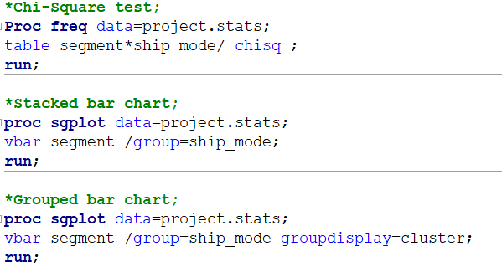

Slide 24
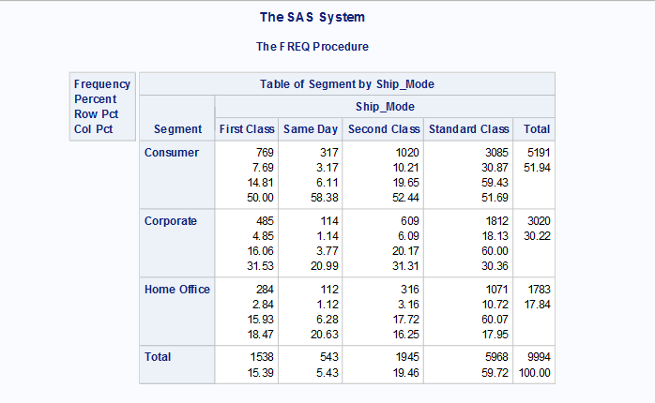
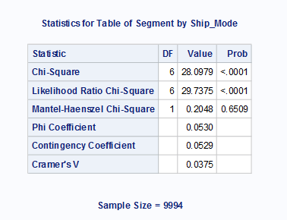
The test statistic of chi-square test is 28.0979
Degree of freedom is
(rows-1 * columns-1)
(3-1)*(4-1) = 6
P-value for the test is very less, which is <.0001

Slide 25
Conclusion of chi-square test
P-value <.0001 which is less than alpha p-value(0.05), this interprets that we reject null hypothesis and accept alternative hypothesis which states that: -
There is relation between type of segment and shipment mode where chi-square value X^2(6) is 28.0979 where 6 is D.F;

Slide 26
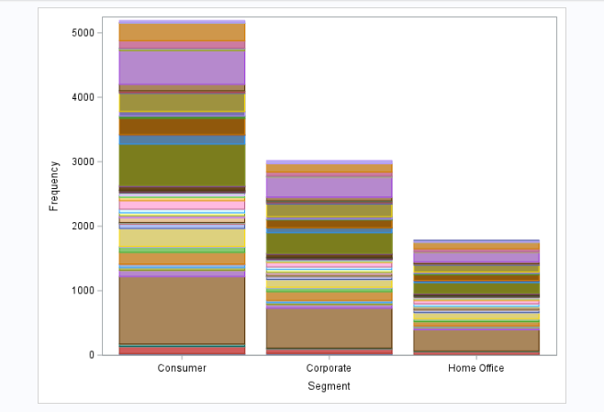
Stacked bar chart for segment and shipment mode

Slide 27
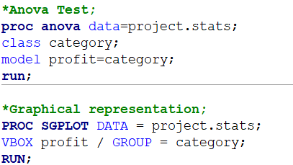
Categorical(more than two levels) with numerical variable
Profit and Category(three levels)
*H0:There is no difference between mean of profit for all three categories;
*H1:There is difference between the mean of profit for three categories;

Slide 28
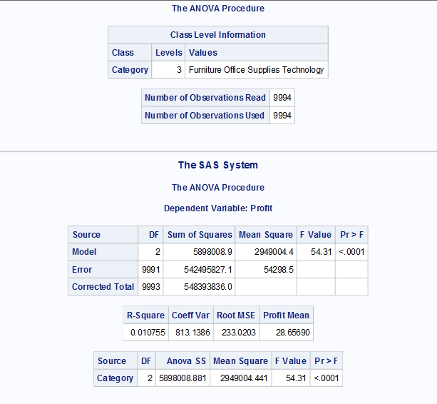

Slide 29
Model is variance explained by the independent variable
Error is the variance that is not explained by the model.
Model DF is (levels-1)=3-1=2
Error DF is Total_obs-levels=9994-3=9991
Corrected DF Total_obs-1=9994-1=9993
Sum of squares for model explains variance represented by model i.e., 5898008.9
Sum of squares for error explains variance that is not explained by variable i.e., 542495827.1
Mean Square of model = 5898008.9 / 2 = 2949004.4
Mean Square of Error = 542495827.1 / 9991 = 54298.5
F-value=Mean Square of Model / Mean square of error=54.31
P-value is <0.0001 less than alpha P-value that is 0.05, strong evidence against null hypothesis, reject null hypothesis.
R-squared is 0.010755 which means 1.07% of variance in profit explains the model, which is very less that means relatively low fit of the model to the data.
Coff of Variance (C.V.) 813.1386 explains the relative variability of profit with respect to its means (standardize the S.D. of variable)
Root MSE (Mean Square Error) 233.0202 explains the standard deviation of the residuals, prediction errors(how well model’s prediction match the data)
Mean of profit is 28.656590 across the observations.

Slide 30
Conclusion based on ANOVA test:
F Value: The overall F-statistic of the ANOVA model.
This is calculated as Mean Square Model / Mean Square Error, which is 54.31.
Pr >F: The most important value in the entire output is the p-value because this tells us whether there is a significant difference in the mean profit between the three groups.
The P-value of the F-test is <0.0001 which is less than the alpha P-value 0.05, that
indicates that we reject null hypothesis and accept the alternative hypothesis
which states that the difference between the mean of profit for different levels of categories is statistically significant.

Slide 31
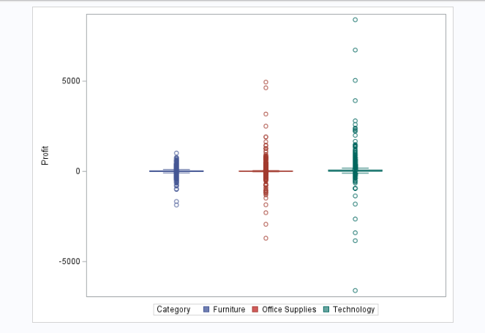

Slide 32
Multivariate analysis
Profit * Category * Sales

Slide 33
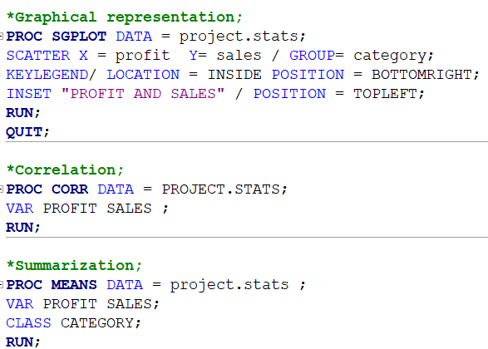

Slide 34
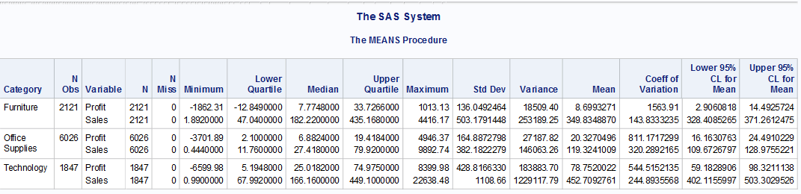
The proc means table explains about the relation between category levels with sales and profit which states
Total observation are 9994 with
Average profit for Furniture between [2.90608,14.4925] with a confidence level of 95%
Average profit for Office supplies between [16.16,24.49] with a confidence level of 95%
Average profit for Technology between [59.18,98.32] with a confidence level of 95%
Average Sales for Furniture between [328.40,371.26] with a confidence level of 95%
Average Sales for Office supplies between [109.57,128.97] with a confidence level of 95%
Average Sales for Technology between [402.11,503.302] with a confidence level of 95%

Slide 35
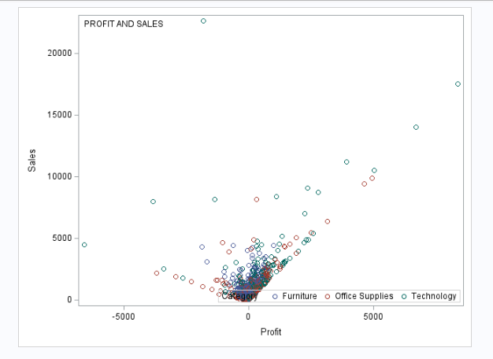

Slide 36
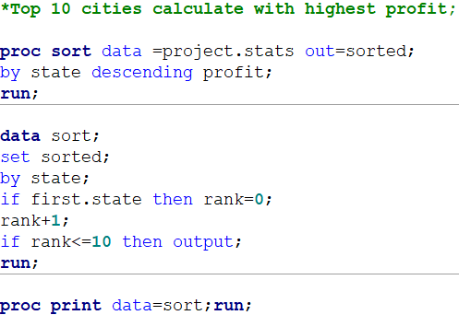

Slide 37


